Slide 1
Object Oriented Programming Lecture-22
Prof. Varsha Dange

Slide 2
Difference between checked & unchecked
checked | unchecked
Checked exceptions checked at compile time. | Unchecked exceptions not checked at compile time
The compiler checks the checked exception. | The compiler does not check these types of exceptions.
They are the sub-class of the exception class. | They are runtime exceptions and direct subclasses of RuntimeException class
It forces to use try –catch block | It not forces to use try –catch block
Examples of Checked exceptions: •File Not Found Exception •No Such Field Exception •Interrupted Exception •No Such Method Exception •Class Not Found Exception | Examples of Unchecked Exceptions: •No Such Element Exception •Undeclared Throwable Exception •Empty Stack Exception •Arithmetic Exception •Null Pointer Exception •Array Index Out of Bounds Exception •Security Exception

Slide 3
Types of handling exception
Keyword | Description
try | The "try" keyword is used to specify a block where we should place an exception code. It means we can't use try block alone. The try block must be followed by either catch or finally.
catch | The "catch" block is used to handle the exception. It must be preceded by try block which means we can't use catch block alone. It can be followed by finally block later.
finally | The "finally" block is used to execute the necessary code of the program. It is executed whether an exception is handled or not.
throw | The "throw" keyword is used to throw an exception explicitly.
throws | The "throws" keyword is used to declare exceptions. It specifies that there may occur an exception in the method. It delegates the exception to caller method. It is always used with method signature.

Slide 4
Try And Catch Blocks
try block is used to enclose the code that might throw an exception.
It must be followed by either catch or finally or both blocks.
Catch block is used for exception handler. It is used after try block.
Finally block is optional
For each try block there can be zero or more catch blocks, but only one finally block.

Slide 5
Try And Catch Blocks
try { // the code you think can raise an exception}
catch(Exception handler class) {// exception handler for ExceptionType1 }
Finally { //block of code to be executed after try block ends ; }

Slide 6
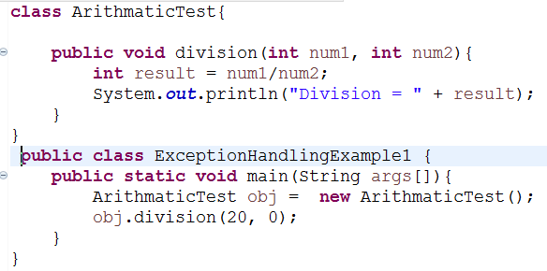
Problem without exception handling

Slide 7
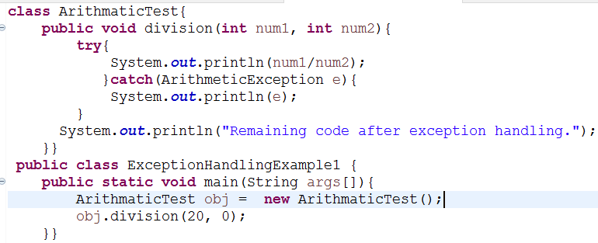

Solution of the above problem using exception handling

Slide 8
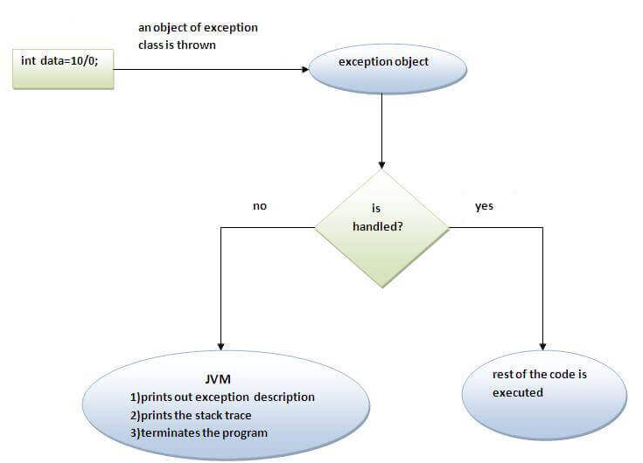
Internal working of java try-catch block

Slide 9
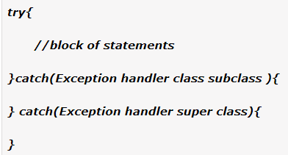
Java Multi-catch block
If more than one exception can occur in one try block, than we can use multiple catch blocks to provide appropriate handler to different exception objects.
`All catch blocks must be ordered from most specific to most general,
i.e. catch for ArithmeticException must come before catch for Exception.

Slide 10
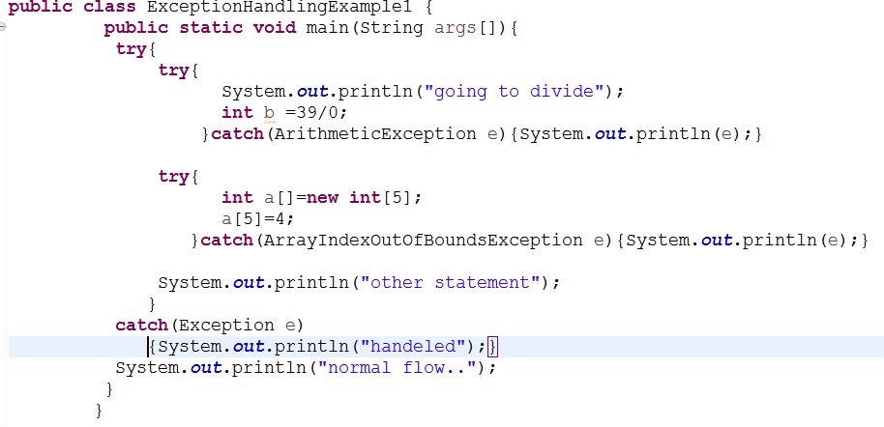
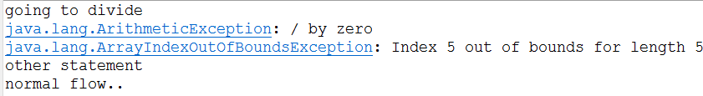
Nested try block
Output :

Slide 11
Java finally block
Java finally block is a block that is used to execute important code such as closing connection, stream etc.
Java finally block is always executed whether exception is handled or not.
Java finally block follows try or catch block.
Finally block in java can be used to put "cleanup" code such as closing a file, closing connection etc.

Slide 12
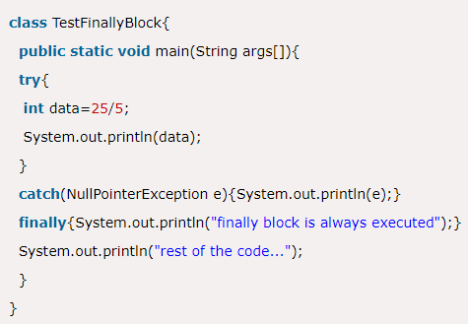

Usage of Java finally Case 1:Exception doesn’t occur

Slide 13
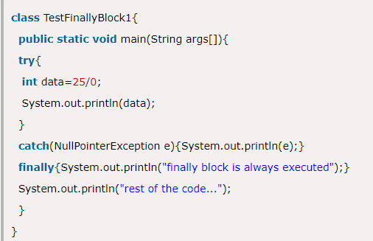

Case 2: exception occurs and not handled

Slide 14
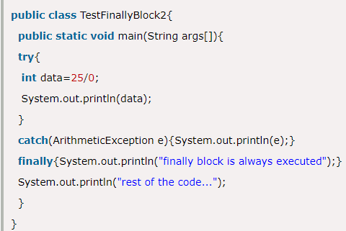

Case 3: exception occurs and handled

Slide 15
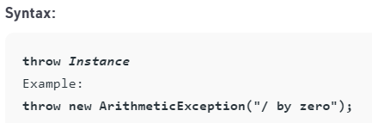
Java throw keyword
The Java throw keyword is used to explicitly throw an exception within a method or block of code.
We can throw either checked or unchecked exception in java by throw keyword.
The throw keyword is mainly used to throw custom exception.
Notes:
Explicit means somthing is done by the programmer Implicit means that i. for example if you dont explicitly create a constructor for your class the compiler will implicitly create default one for youts done by the complier

Slide 16
Contd…
The flow of execution of the program stops immediately after the throw statement is executed and
transfers from the try block to the catch block.
If no matching catch is found then the default exception handler will halt the program.

Slide 17
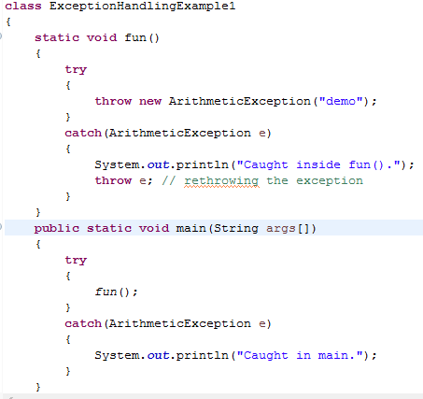

Contd...

Slide 18
Contd...

Slide 19
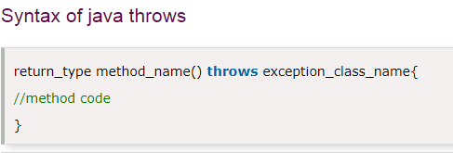
throws keyword
throws is used to throw an exception object implicitly.
It delegates exception to caller methods
Then caller method has to use try-catch block
It is used with the method signature.
to declare the type of exceptions that might occur within method.
More than one type of exception can be declared with method signature, they should be comma separated.

Slide 20
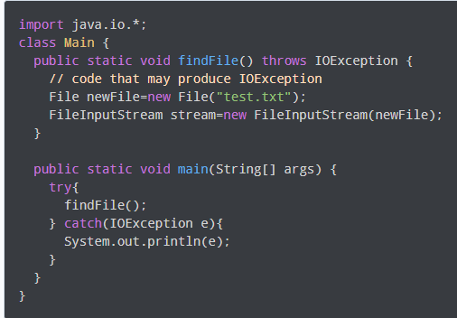
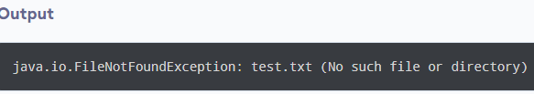
Contd…

Slide 21
Advantage of Java throws keyword
It provides information to the caller of the method about the exception.
Checked Exception can be propagated (forwarded in call stack).

Slide 22
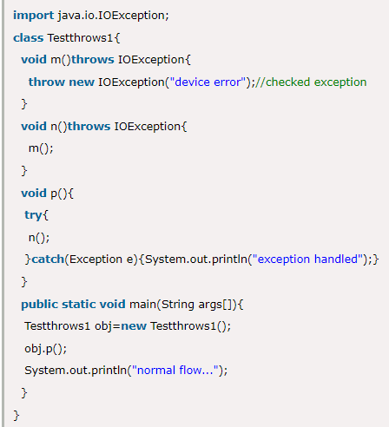
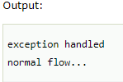
Contd…

Slide 23
Contd…
Only checked exceptions are required to be thrown using the throws keyword.
Unchecked exceptions don’t need to be thrown

Slide 24
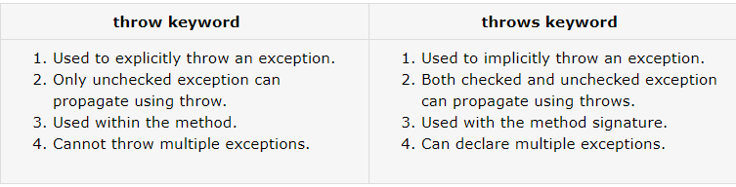
Difference between throw and throws.

